Slide 1

Smart Queue System
Prepared By:
K. SINDHU BHARATHI(24BQ1A4370)
K. NAGA NIVEDITHA(24BQ1A4390)
M. RAMYA(24BQ1A43A7)
N. SRAVANI(24BQ1A43B4)
P. VARSHINI(24BQ1A43C4)

Slide 2
Problem Statement:
In today’s growing urban environments, bus stops often face overcrowding and unorganized passenger queues, especially during peak hours. Commuters lack real-time information about bus arrivals, waiting times, and boarding order, which leads to confusion and delays. Vulnerable groups such as senior citizens and people with disabilities are particularly affected by this situation. Moreover, transport authorities do not have accurate data on passenger demand at bus stops, resulting in inefficient scheduling. Therefore, a smart queue management system is needed to organize boarding, reduce congestion, and improve public transport efficiency.
Objectives:
To understand the challenges faced by commuters at busy bus stops
To identify problems related to overcrowding and unorganized queues
To explore how a smart queue management system can improve the waiting experience
To reduce congestion and waiting time during peak hours
To ensure fair, safe, and organized boarding for all passengers

Slide 3
Understanding the Problem Space:
Bus stops experience heavy overcrowding during peak hours due to high passenger demand
Lack of organized queue systems leads to confusion while boarding buses
Commuters do not receive real-time information about bus arrivals and waiting times
Overcrowding negatively impacts safety, time efficiency, and user satisfaction
There is a clear opportunity to use technology-based solutions to improve queue management
Key Findings from Exploration:
Most bus stops lack a defined or visible queue system, leading to confusion
Passengers often rush toward buses, causing queue jumping and conflicts
Elderly people, women, and persons with disabilities face difficulty boarding safely
Overcrowding increases the risk of accidents and service delays
Bus drivers and conductors find it difficult to manage boarding efficiently
Passengers do not receive real-time information about waiting time or queue position

Slide 4
Stakeholder Analysis:
Primary Stakeholders:
Commuters / Passengers: Use the system for organized and fair boarding, reduced waiting time, and real-time queue information
Elderly & Persons with Disabilities: Receive priority access, safer boarding, reduced crowd pressure, and better accessibility
Secondary Stakeholders:
Bus Drivers & Conductors: Manage boarding efficiently, reduce conflicts, maintain schedules, and improve service flow
Transport Authorities & Safety Personnel: Monitor operations, analyze passenger data, improve scheduling, and ensure crowd safety
Tertiary Stakeholders:
Technology Providers: Design, develop, maintain the system, and ensure reliability, scalability, and usability
Local Government & Businesses: Support urban planning decisions, manage congestion, and benefit from smoother pedestrian movement

Slide 5
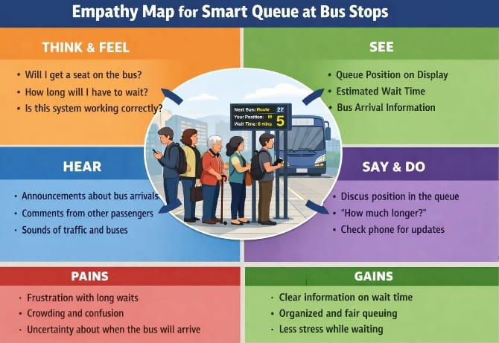
Empathy Map:

Slide 6
Define:
How Might We (HMW) Questions Based on Passenger Needs (Smart Queue System)
How might we provide accurate real-time bus arrival information to commuters at bus stops?
How might we reduce overcrowding and confusion during peak hours?
How might we create a fair and organized queue system for smooth and disciplined boarding?
How might we design a simple and accessible system usable by all age groups, including senior citizens?
How might we make waiting at bus stops safer, less stressful, and more predictable for commuters?

Slide 7
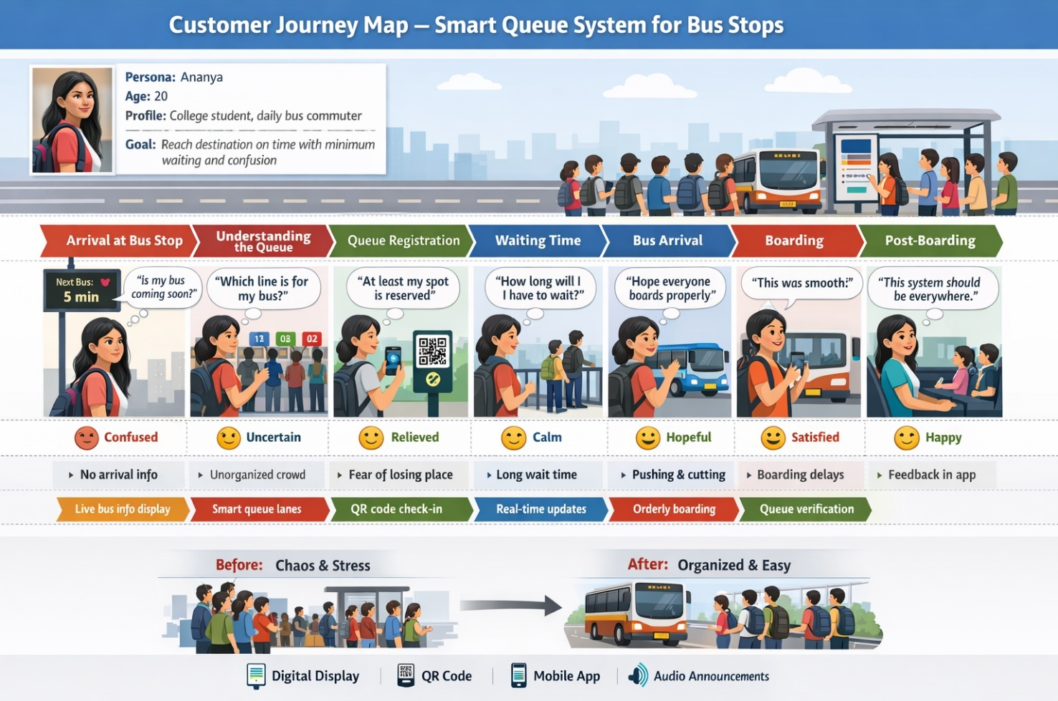
Customer Journey Map:

Slide 8
IDEATE – Structuring Ideas:
Storyboarding for Smart Queue System (Bus Stop)
Used storyboarding to visualize the complete commuter journey at the bus stop
Broke down the experience into key interaction and decision points
Each visual panel represents actions at the bus stop or within the mobile application
Helped identify pain points such as long waiting times and overcrowding
Enabled the design of a smoother, safer, and more organized boarding experience

Slide 9
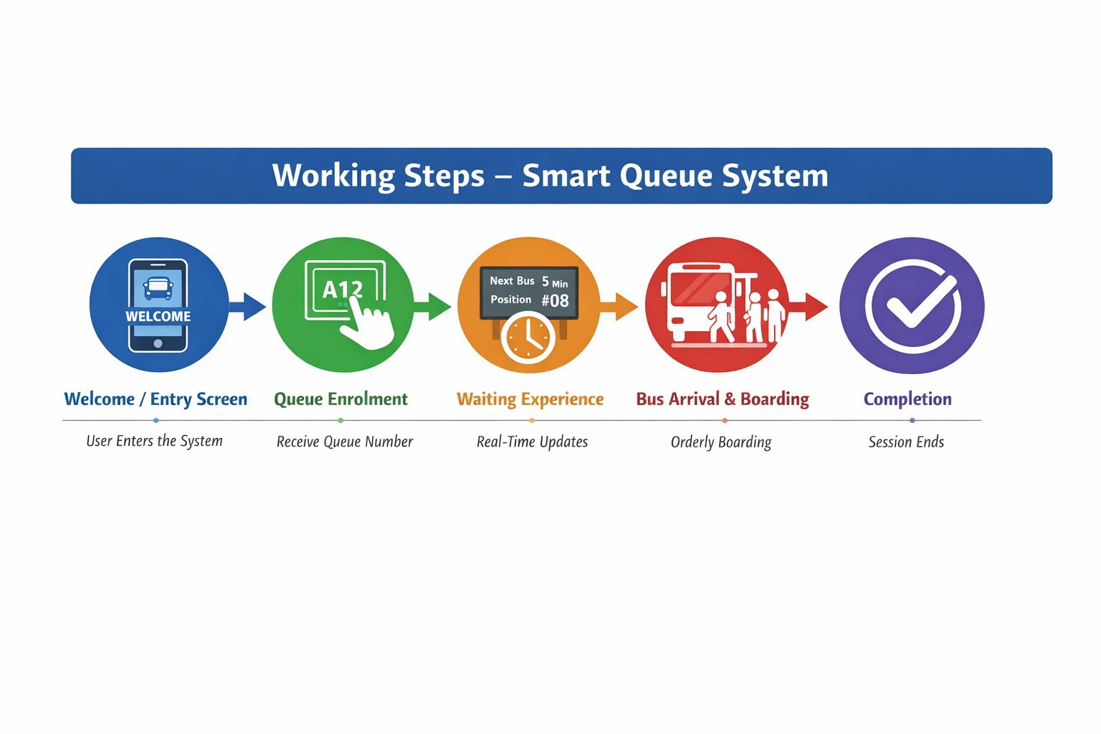
Working Steps – Smart Queue System:
Step 1: Welcome / Entry Screen User enters the system and views basic instructions or bus stop details.
Step 2: Queue Enrolment Passenger enrolls into the digital queue and receives a token or queue number.
Step 3: Waiting Experience User views real-time updates on waiting time, queue position, and bus arrival.
Step 4: Bus Arrival & Boarding Passengers are notified and guided for orderly and priority-based boarding.
Step 5: Completion Boarding is completed and the queue session ends successfully.

Slide 10
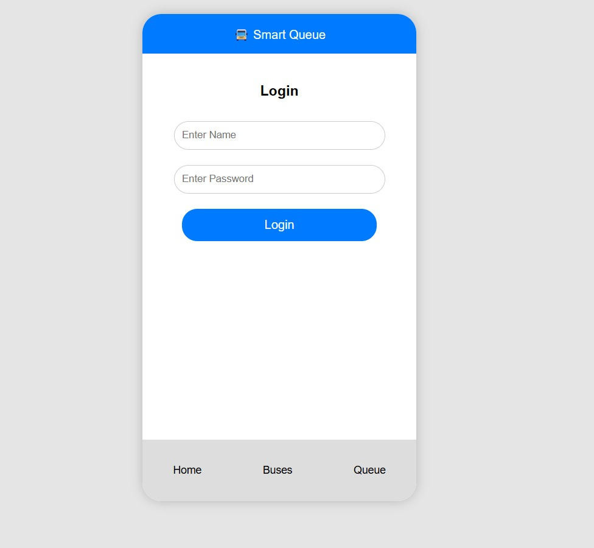
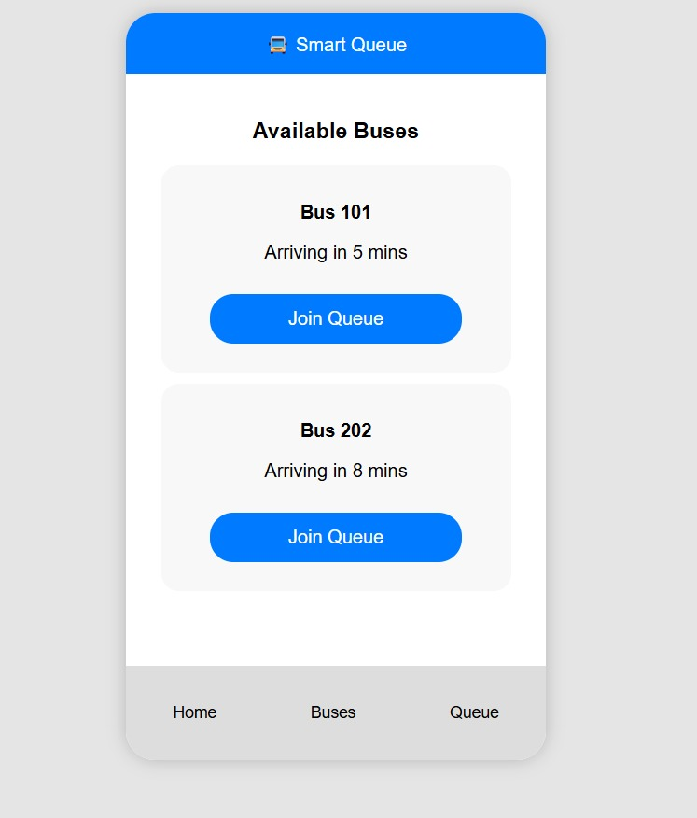
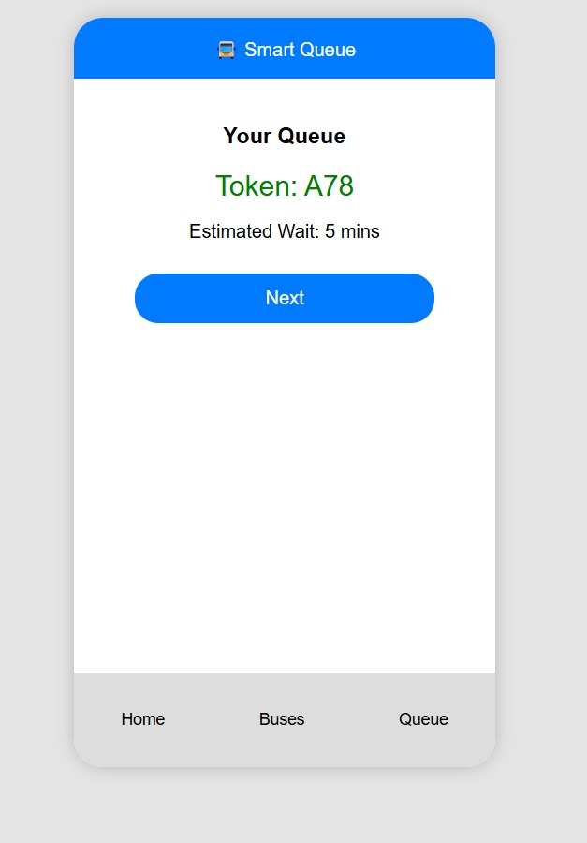
Step 1: Welcome / Entry Screen
Step 2: Queue Enrolment

Slide 11
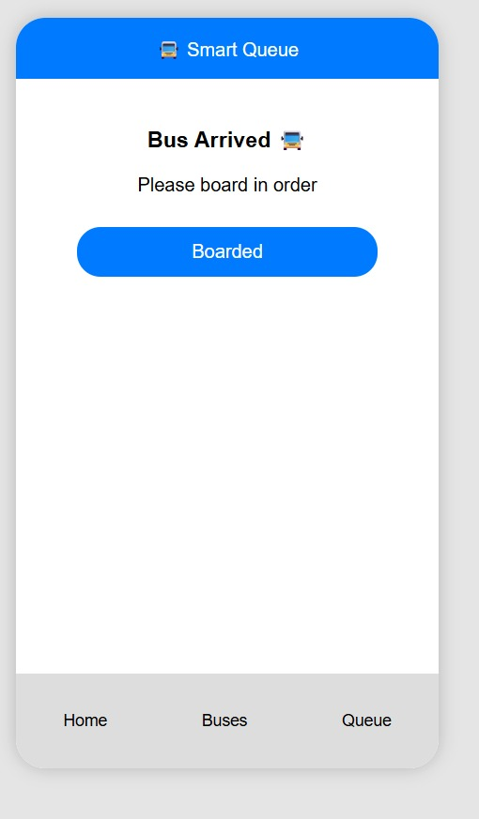
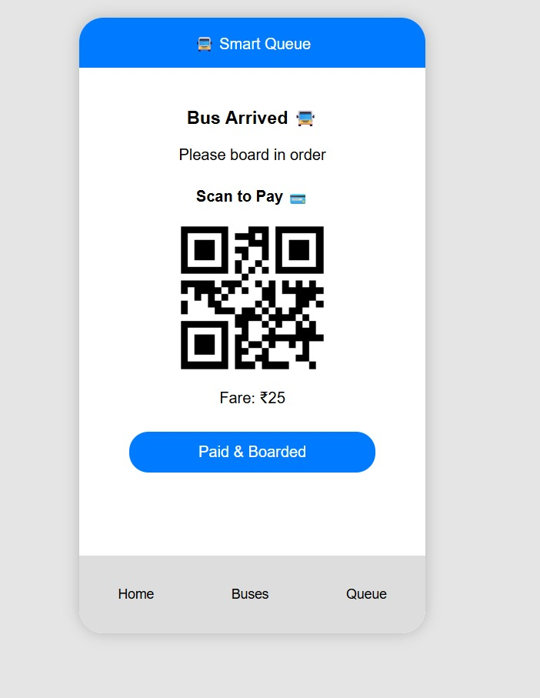
Step 3: Bus Arrival & Boarding
Step 4: Payement

Slide 12
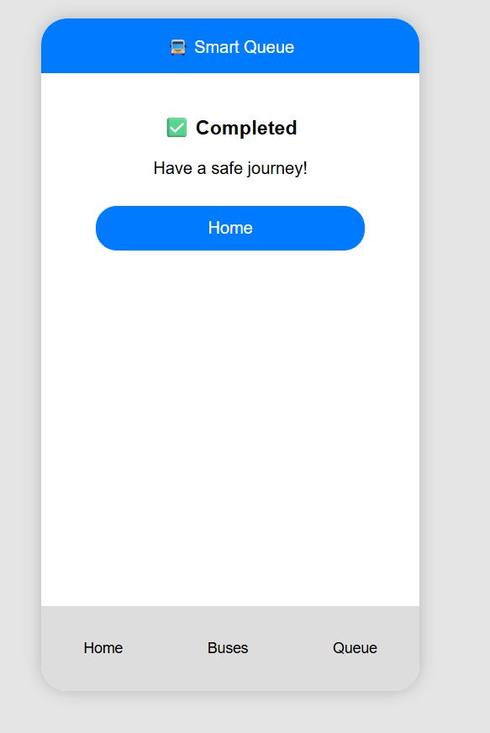
Step 5: Completion

Slide 13
PROTOTYPE – Click-Through Prototype:
Overview: Interactive digital mock-up simulating user flow, bus arrival details, digital queue joining, notifications, and organized boarding.
Benefits:
Simulates commuter journey from bus stop entry to boarding
Provides real-time bus updates, queue positions, and alerts
Cost and time efficient; allows early feedback
Identifies usability, accessibility, and navigation issues
Supports stakeholder and commuter feedback for iteration
Creation Approach:
Tools: Figma, Adobe XD, InVision
Key Screens: Home, Scan QR / Stop ID, Available Buses, Queue Status, Boarding Notification, Feedback
Interactions: Scan QR → Join Queue → View Bus Details → Board Now
Features: Transport-friendly colors, icons, smooth transitions

Slide 14
USABILITY TESTING – Smart Queue System:
Purpose:
Observe real users interacting with the prototype to evaluate usability, navigation, and functionality
Identify main points, improve user flow, and enhance commuter experience
Key Steps:
Define Goals: Test queue joining, token checking, notifications
Select Participants: 5–10 users (commuters, elderly, staff)
Create Scenarios: Tasks like joining queue, viewing status, responding to alerts
Conduct Test: Independent interaction with observation, think-aloud encouraged
Collect Feedback & Analyse Results: Identify difficulties, unclear info, or failed tasks
Implement Improvements: Simplify navigation, improve clarity, enhance notifications
Focus Areas:
Navigation, content layout, interactive elements, feedback mechanisms
Early issue detection saves time & cost, improves user satisfaction, reduces waiting stress

Slide 15
Thank you

